Slide 1
SnapWik
An Android based mobile application for Image and Text recognition and producing information about the scanned object.

Slide 2
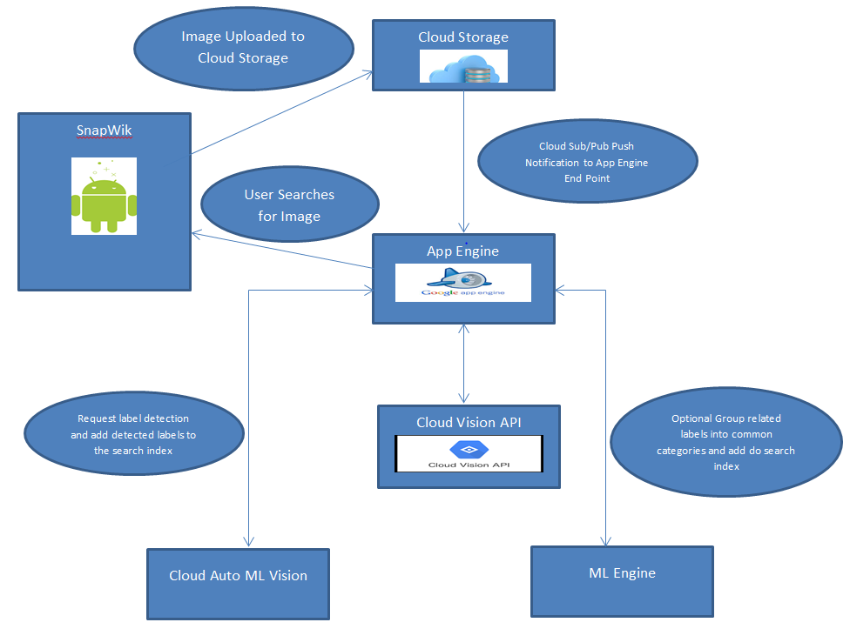
SnapWik Architecture

Slide 3
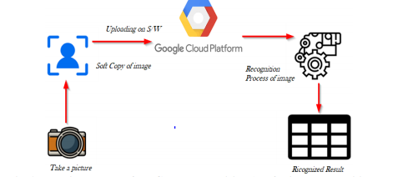
How it Works!!

Slide 4
Unified Process
Communication
Planning
Modeling
Construction
Deployment

Slide 5
Versioning
v1:Pilot
First version was a basic android application
Added button functionality, Tested on android OS.
v2:Picture-pedia
Configuration of vision API in android application
Result extraction based on confidence level
v3:SnapWik
Added camera functionality
UI enhancements

Slide 6
Design
SnapWik is powered by Google Vision API, which is a Google’s deep learning model for detection of static object.
SnapWik capabilities include detection of objects, Labels, faces and landmarks.
ML Vision uses training data set and based on the result, it assign the confidence level to each objects range from 0(no confidence) to 1(high confidence).
Results are displayed on SnapWik in a graphical cloud(Tag Cloud) form where size of each words represent their confidence level

Slide 7

Demo Time!

Slide 8
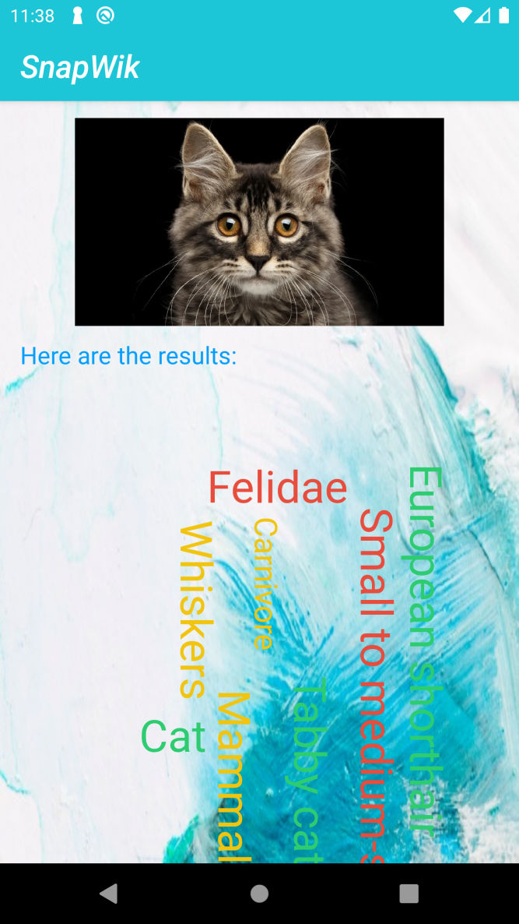
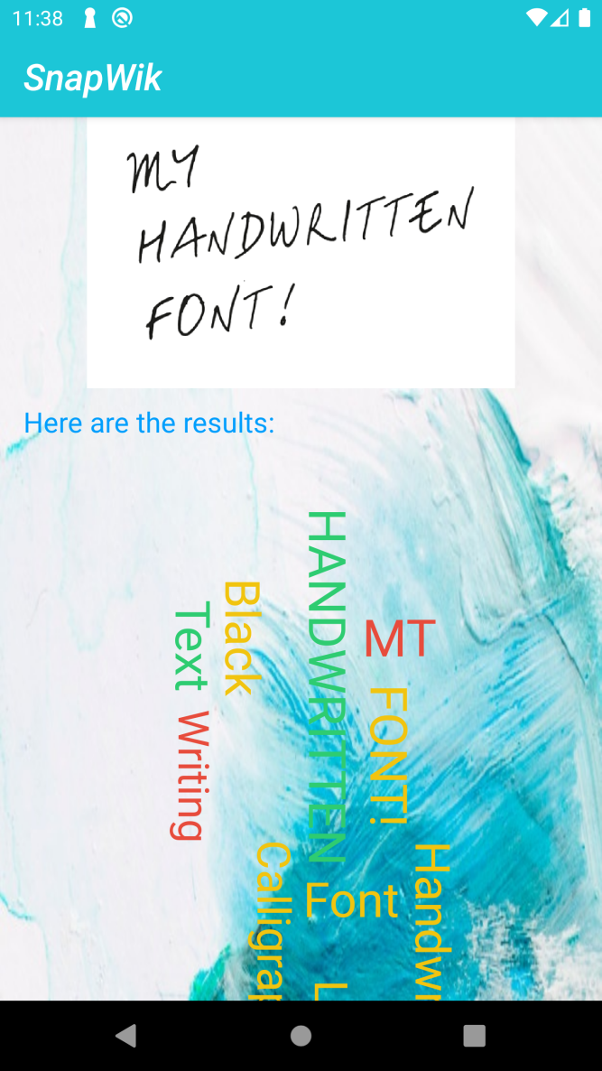
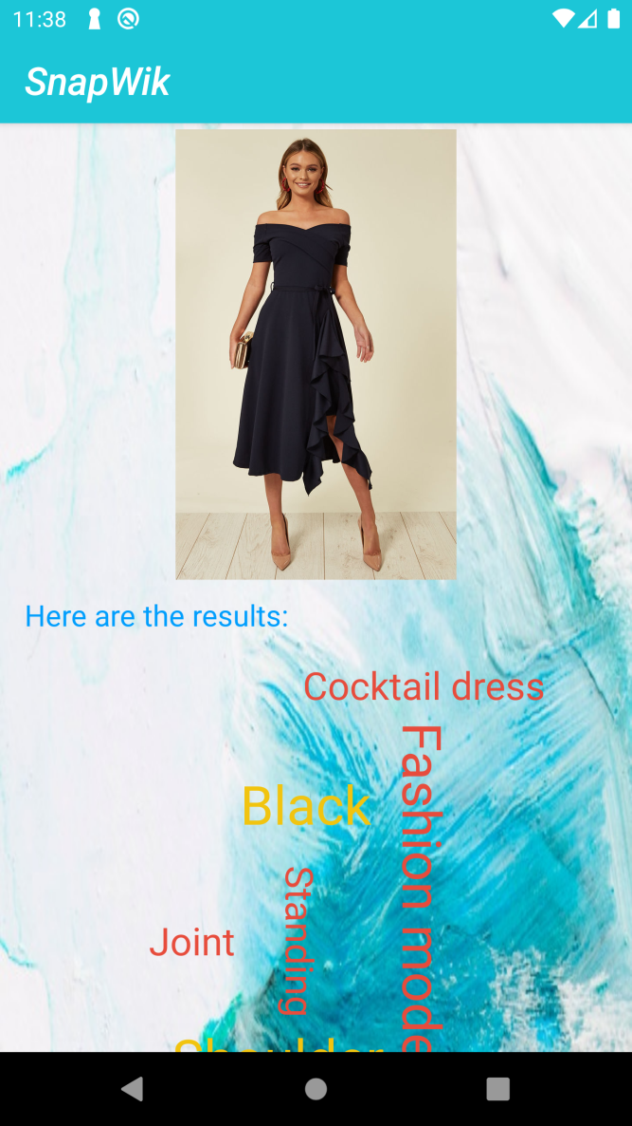

Slide 9
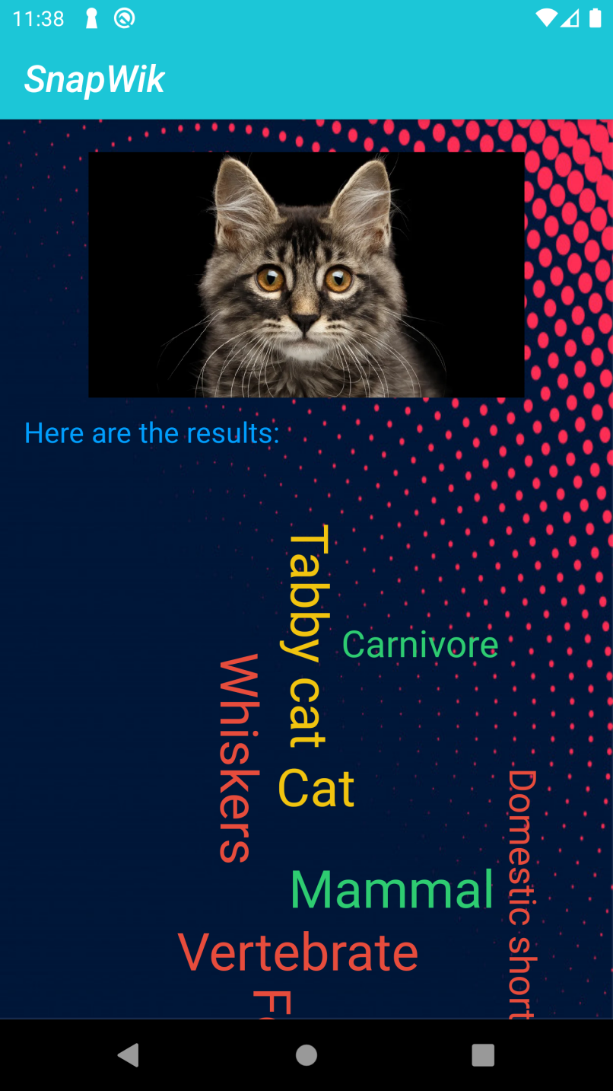
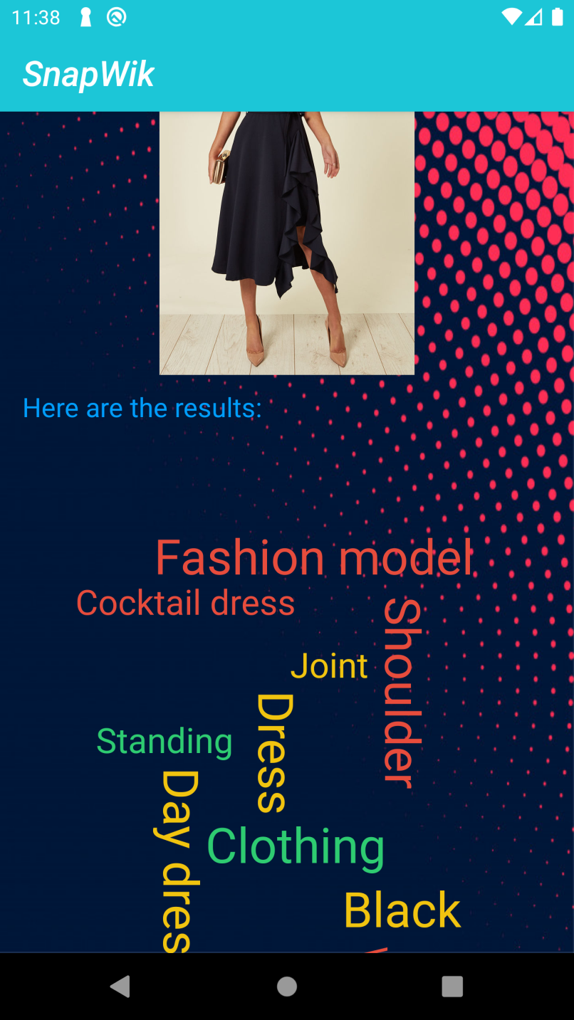
Dark Themes

Slide 10
Challenges Faced
Configuration of OAuth and API key for validation and verification
Keyword extraction based on the confidence level
Native camera integration for real time images
Graphical text generation by using Tag Cloud

Slide 11
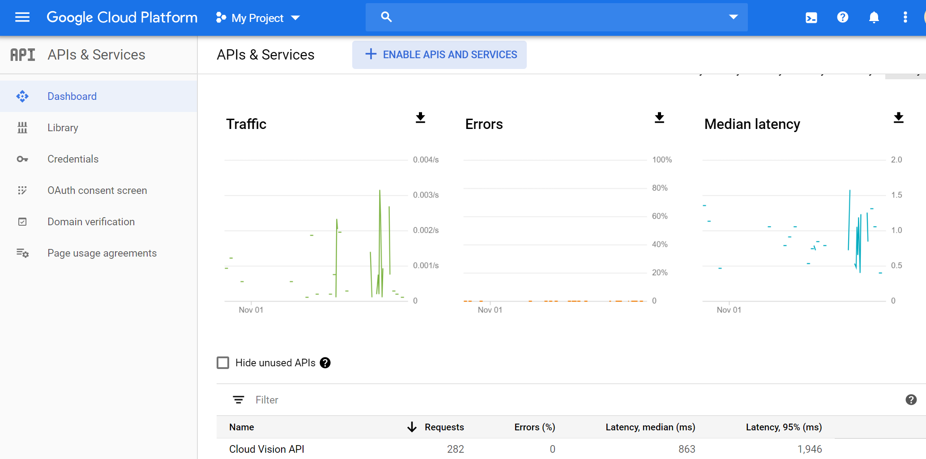
User Analytics

Slide 12
Future Scope
To remove the Google Vision engine with our own Machine Learning model to train it from the training data set and apply those training on the testing data.

Slide 13

Questions

